Slide 1

Data Integrity
Integrity without knowledge is weak and useless, and knowledge without integrity is dangerous
Samuel Johnson, 1759

Slide 2
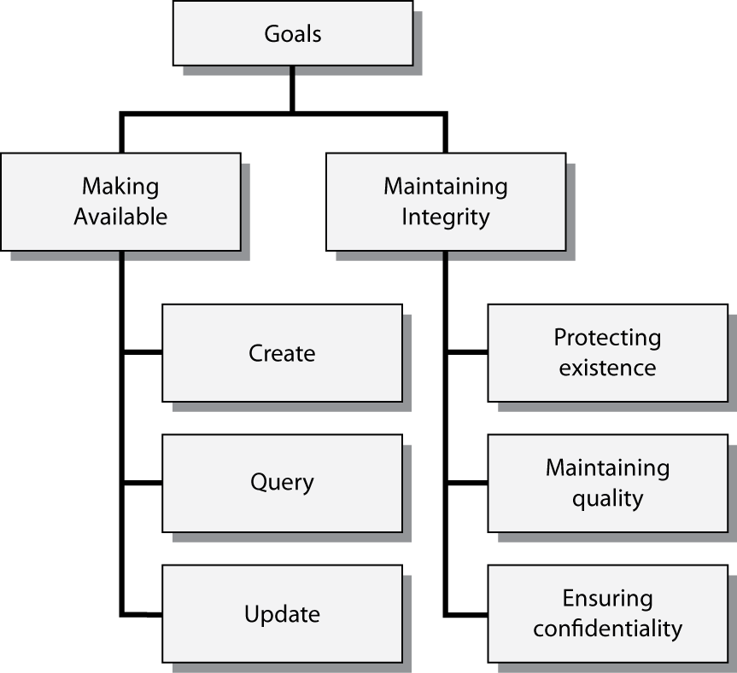
Management of organizational memories

Slide 3
Strategies for data integrity
Protecting existence
  Preventative
    Isolation
  Remedial
    Database backup and recovery
Maintaining quality
  Update authorization
  Integrity constraints
  Data validation
  Concurrent update control
Ensuring confidentiality
  Data access control
  Encryption

Slide 4
Strategies for data integrity
Legal
  Privacy laws
Administrative
  Storing database backups in a locked vault
Technical
  Using the DBMS to enforce referential integrity constraint

Slide 5
Transaction processing
A transaction is a series of actions to be taken on the database such that they must be entirely completed or aborted
A transaction is a logical unit of work
Example
  BEGIN TRANSACTION;
  EXEC SQL INSERT …;
  EXEC SQL UPDATE …;
  EXEC SQL INSERT …;
  COMMIT TRANSACTION;

Slide 6
ACID
Atomicity | If a transaction has two or more discrete pieces of information, either all of the pieces are committed or none are
Consistency | A transaction either creates a valid new database state, or, if any failure occurs, the transaction manager returns the database to its prior state
Isolation | A transaction in process and not yet committed must remain isolated from any other transaction
Durability | Committed data are saved by the DBMS so that, in the event of a failure and system recovery, these data are available in their correct state

Slide 7
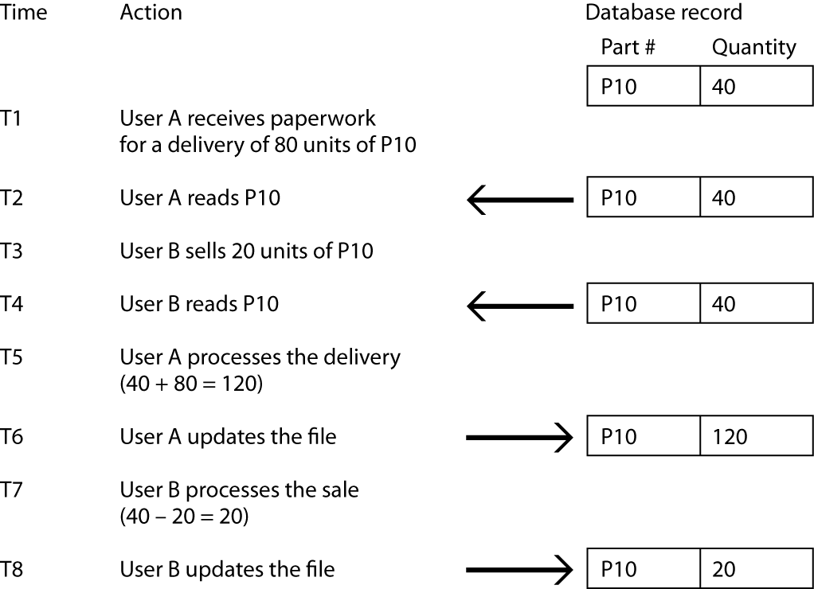
Concurrent update
The lost data problem

Slide 8
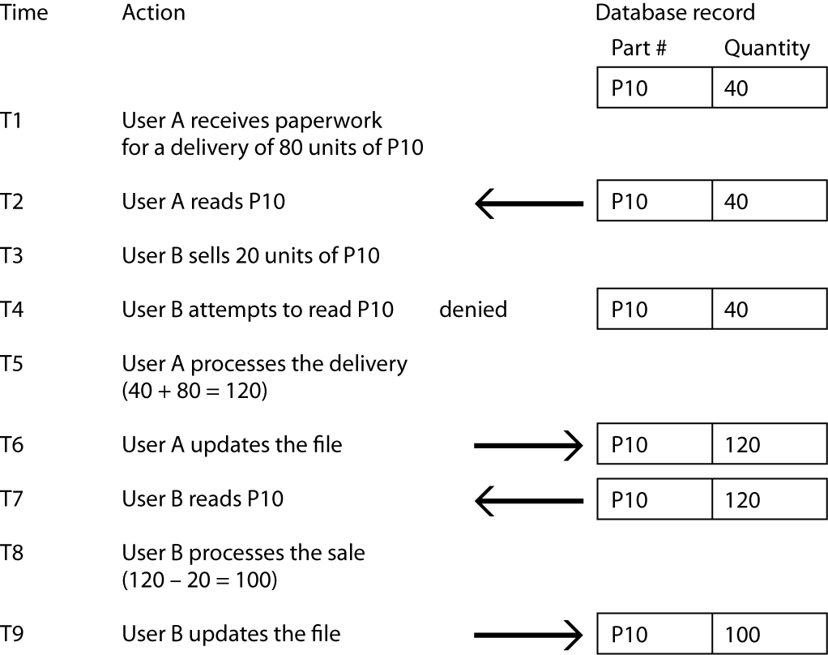
Concurrent update
Avoiding the lost data problem

Slide 9
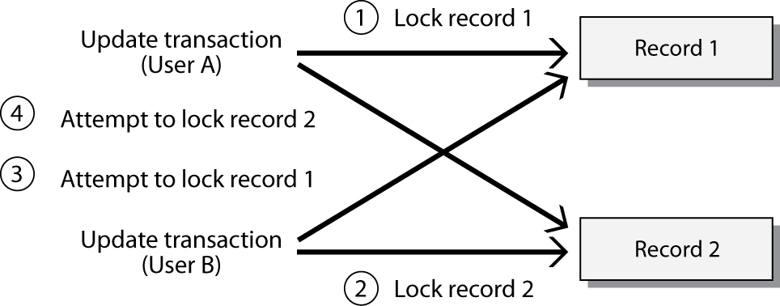
Concurrent update
The deadly embrace
  User A’s update transaction locks record 1
  User B’s update transaction locks record 2
  User A attempts to read record 2 for update
  User B attempts to read record 1 for update

Slide 10
Database update process
U
p
d
a
t
e
U
p
d
a
t
e
U
p
d
a
t
e
t
r
a
n
s
a
c
t
i
o
n
A
t
r
a
n
s
a
c
t
i
o
n
B
t
r
a
n
s
a
c
t
i
o
n
C
D
a
t
a
b
a
s
e
D
a
t
a
b
a
s
e
D
a
t
a
b
a
s
e
D
a
t
a
b
a
s
e
(
s
t
a
t
e
1
)
(
s
t
a
t
e
2
)
(
s
t
a
t
e
3
)
(
s
t
a
t
e
4
)
D
a
t
a
b
a
s
e
(
s
t
a
t
e
2
)

Slide 11
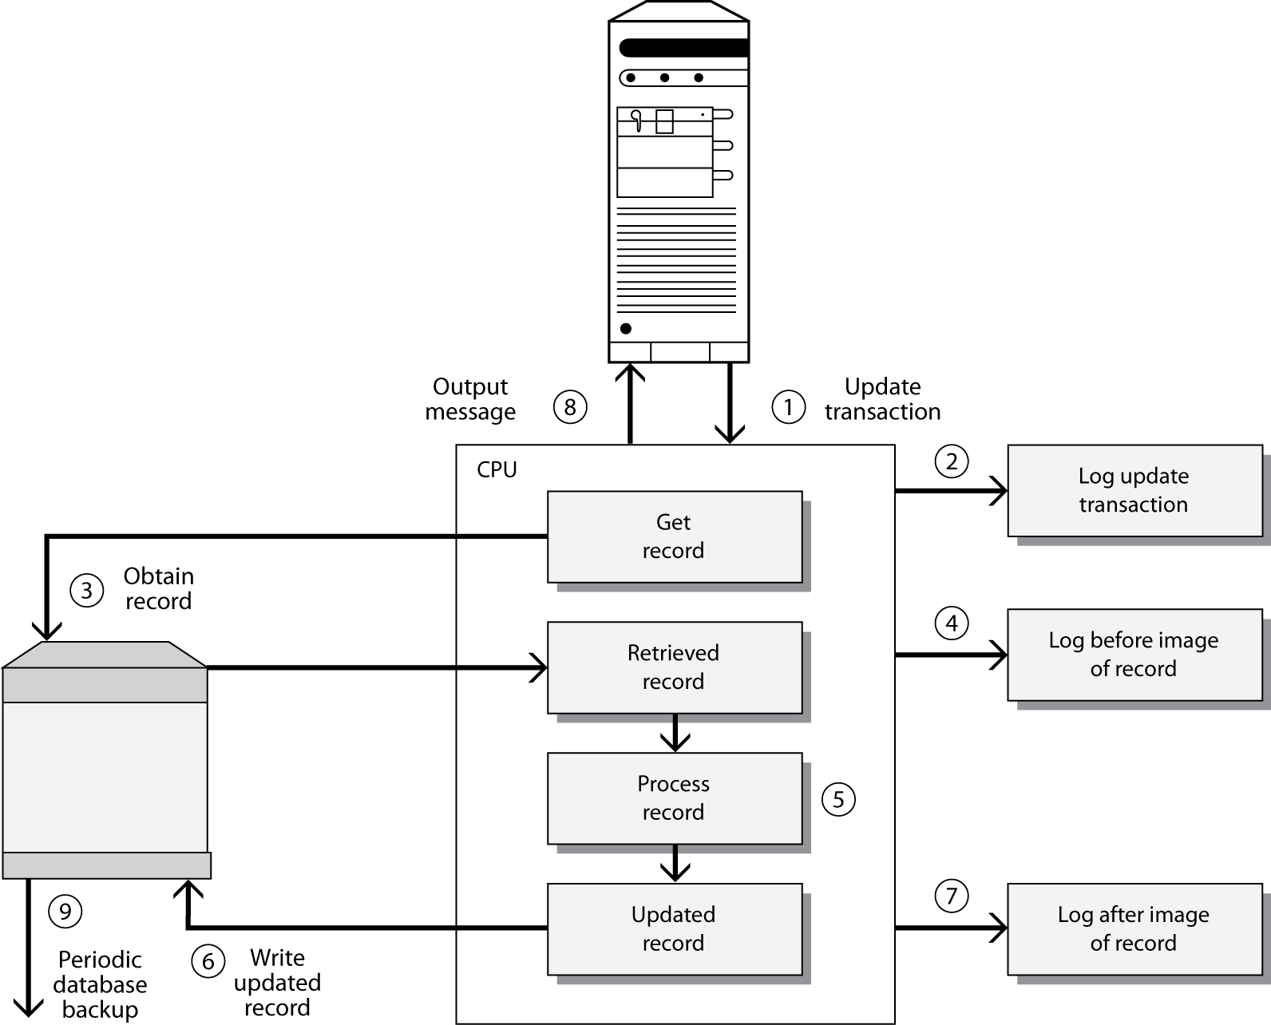
Potential backup procedures

Slide 12
Backup options
Objective | Action
Complete copy of database | Dual recording of data (mirroring)
Past states of the database (also known as database dumps) | Database backup
Changes to the database | Before image log or journal After image log or journal
Transactions that caused a change in the state of the database | Transaction log or journal

Slide 13
Transaction failure and recovery
Program error
Action by the transaction manager
Self-abort
System failure

Slide 14
Recovery strategies
Switch to a duplicate database
  RAID technology approach
Backup recovery or rollback
  Return to prior state by applying before-images
Forward recovery or rollforward
  Recreate by applying after-images to prior backup
Reprocess transactions

Slide 15
Data recovery
Problem | Recovery Procedures
Storage medium destruction (database is unreadable) | *Switch to duplicate database—this can be transparent with RAID Forward recovery Reprocess transactions
Abnormal termination of an update transaction (transaction error or system failure) | *Backward recovery Forward recovery or reprocess transactions—bring forward to the state just before termination of the transaction
Incorrect data detected (database has been incorrectly updated) | *Backward recovery Reprocess transactions (Excluding those from the update program that created incorrect data)
 | * preferred strategy

Slide 16
Transaction processing recovery procedures
MAIN
* If an error occurs perform undo code block
1 EXEC SQL WHENEVER SQL ERROR PERFORM UNDO
* Insert a single row in table A
2 EXEC SQL INSERT
* Update a row in table B
3 EXEC SQL UPDATE
* Successful transaction, all changes are now permanent
4 EXEC SQL COMMIT WORK
5 PERFORM FINISH
UNDO
* Unsuccessful transaction, rollback the transaction
6 EXEC SQL ROLLBACK WORK
FINISH
EXIT

Slide 17
Data quality
Definition
  Data are high quality if they fit their intended uses in operations, decision making, and planning. They are fit for use if they are free of defects and possess desired features.
Determined by the customer
Relative to the task

Slide 18
Data quality
Poor quality data
  Customer service declines
    Effectiveness loss
  Data processing is interrupted
    Efficiency loss

Slide 19
Customer-oriented data quality
Firm performance variation | High | Tracking Performance deviation | Knowledge management Advice
 | Low | Transaction processing Confirmation | Expert system Recommendation
 |  | Low | High
 |  | Customer uncertainty

Slide 20
Data quality generations
First
  Finding and correcting existing errors
Second
  Preventing errors at the source
Third
  Defects are highly unlikely
  Six-sigma standards
    3.4 defects per million transactions

Slide 21
Integrity constraints
Type of constraint | Explanation | Example
TYPE | Validating a data item value against a specified data type. | Supplier number is numeric.
SIZE | Defining and validating the minimum and maximum size of a data item. | Delivery number must be at least 3 digits and at most 5.
VALUES | Providing a list of acceptable values for a data item. | Item colors must match the list provided.
RANGE | Providing one or more ranges within which the data item must fall or must NOT fall. | Employee numbers must be in the range 1-100.
PATTERN | Providing a pattern of allowable characters which define permissible formats for data values. | Department phone number must be of the form 542-nnnn (stands for exactly four decimal digits).
PROCEDURE | Providing a procedure to be invoked to validate data items. | A delivery must have valid itemname, department, and supplier values before it can be added to the database. (Tables are checked for valid entries.)
CONDITIONAL | Providing one or more conditions to apply against data values. | If item type is ‘Y’, then color is null.
NOT NULL (MANDATORY) | Indicating whether the data item value is mandatory (not null) or optional. The not null option is required for primary keys. | Employee number is mandatory.
UNIQUE | Indicating whether stored values for this data item must be unique (unique compared to other values of the item within the same table or record type). The unique option is also required for identifiers. | Supplier number is unique.

Slide 22
Integrity constraints
Example | Explanation
CREATE TABLE stock ( stkcode CHAR(3), …, natcode CHAR(3), PRIMARY KEY(stkcode), CONSTRAINT fk_stock_nation FOREIGN KEY (natcode) REFERENCES nation ON DELETE RESRICT); | Column stkcode must always be assigned a value of 3 or less alphanumeric characters. stkcode must be unique because it is a primary key. Column natcode must be assigned a value of 3 or less alphanumeric characters and must exist as the primary key of nation. Do not allow the deletion of a row in nation while there still exist rows in stock containing the corresponding value of natcode.

Slide 23
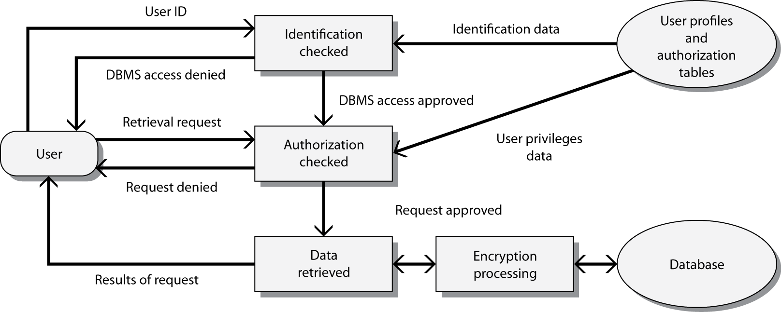
A general model of data security

Slide 24
Authenticating mechanisms
Information remembered by the person
  Name
  Account number
  Password
Object possessed by the person
  Badge
  Plastic card
  Key
Personal characteristic
  Fingerprint
  Signature
  Voiceprint
  Handsize

Slide 25
Authorization tables
Indicate authority of each user or group
Subject/Client | Action | Object | Constraint
Accounting department | Insert | Supplier record | None
Purchase department clerk | Insert | Supplier record | If quantity < 200
Purchase department supervisor | Insert | Delivery record | If quantity ≥ 200
Production department | Read | Delivery record | None
Todd | Modify | Item record | Type and color only
Order processing program | Modify | Sale record | None
Brier | Delete | Supplier record | None

Slide 26
SQL authorization
Grant
  Giving privileges to users
Revoke
  Removing privileges
Notes:
Covered in chapter 9

Slide 27
Firewall
A device placed between an organization’s network and the Internet
Monitors and controls traffic between the Internet and Intranet
Approaches
  Restrict packets to those with designated IP addresses
  Restrict access to applications

Slide 28
Encryption
Encryption is as old as writing
Sensitive information needs to remain secure
Critical to electronic commerce
Encryption hides the meaning of a message
Decryption reveals the meaning of an encrypted message

Slide 29
Public key encryption
Sender
Encrypt
Decrypt
Receiver
Receiver’s
public key
Receiver’s
private key

Slide 30
Signing
Message authentication
Sender
Sign
Verify
Receiver
Sender’s
private key
Sender’s
public key

Slide 31
Monitoring activity
Audit trail analysis
  Time and date stamp all transactions
Monitor a sequence of queries
  Tracker queries

Slide 32
Tracker queries
SELECT COUNT(*) FROM faculty
WHERE dept = 'MIS'
AND age >= 40 and age <= 5;0
10
SELECT COUNT(*) FROM faculty
WHERE dept = 'MIS'
AND age >= 40 and age <= 50
AND degree_from = 'Minnesota';
2
SELECT COUNT(*) FROM faculty
WHERE dept = 'MIS'
AND age >= 40 and age <= 50
AND degree_from = 'Minnesota'
AND marital_status = 'S';
1
SELECT AVG(SALARY) FROM faculty
WHERE dept = 'MIS'
AND age >= 40 and age <= 50
AND degree_from = 'Minnesota'
AND marital_status = 'S';
85,000

Slide 33
Conclusion
Data integrity is essential for quality decision making
Many actions need to be taken to ensure high levels of data integrity
  Protecting existence
  Authentication
  Backup and recovery
  Encryption

